Slide 1
Escambia County Public Schools
Health Services
MEDICATION ADMINISTRATION
2025-2026
Annual Review
Presented by: Betty Hagans, MSN, RN School Health Coordinator

Slide 2
Have you taken an in person class in prior years?
This module is intended for staff who have previously completed the Initial Health Services medication training in person.
This module, post-test and check-off of skills by RN fulfills the annual update requirement for staff administering medications.

Slide 3
Health Services Webpage https://www.escambiaschools.org/health_services
All information and forms related to school health will be found on this webpage.
Before checking medications into the clinic you must verify that the parent has given consent on the health verification form. These forms can be found in a binder in the clinic.
You will need TWO forms to check in medication
    Dispersion of Medication form
    Student Medication Record (SMR) OR PRN (as needed) student Medication Record

Slide 4
Dispersion of Medication form
DISPERSION OF MEDICATION FORM 6-11-2025 (28).docx
Use link above to access the form
This form is used to check all medication into the clinic.
Staff will fill out the form. A parent should not fill it out.
The label must be written EXACTLY as it is printed on the prescription label.
Time due: Must be a time. If the bottle reads to be given at lunch, the lunch time will be verified and that time will be the time due.
Allergies- Never write N/A. If student does not have any allergies, none or NKA (no known allergies) will be written.
Parent or guardian will sign the bottom of this form as well as the staff checking in the medication.
If parent does not sign the form in front of staff, the form must be notarized.

Slide 5
Student Medication Record (SMR)
Copy of SMR Scheduled 2025-2026.xlsx
Copy of SMR PRN 2025 - 2026..xlsx
Use the link above to access forms
For daily medications use Scheduled SMR
For as needed medications SMR PRN will be used.
Medication will be counted and the amount received will be written on this form.
The parent/guardian will sign and the staff receiving medication will sign below.
Check expiration date of medication before filling out paperwork

Slide 6
Students Carrying Medication
Students can possess and self-administer over-the-counter headache medication on school property and at school-sponsored events without a physician's note or prescription, as long as it is a (FDA)-regulated product intended for over-the-counter headache treatment. Students are responsible for using the medication solely for themselves. Medication should be in original bottle.
Students may carry an Inhaler, Epinephrine, Pancreatic Enzymes, Diabetes Medication and Supplies only if the following is complete
    Physician must Sign part 3 of the Dispersion of Medication Form
    Physician must check the carry and self administration box.
    Parent must sign part 4 of the Dispersion of Medication Form
    Student will be given a copy of this form to carry with the medication.
    This form will be placed in the Medication book.

Slide 7
IMPORTANT
All medication must be in the original bottle.
Do not take medication if it is different colors, shapes and sizes.
Medication must be counted.
Morning medication doses should be given at home. Morning doses need approval by the RN supervisor and will only be given for extenuating circumstances.
Medications must be FDA approved.
Medications cannot be expired. Emergency medications and Inhalers will have a label expiration date as well as a medication expiration date.
Do not discuss student’s medical care with other staff.
Do not use white out. Draw a line through error and intial.
When taking in a refill- If the label reads differently than the Dispersion of Medication form, you MUST fill out a new Dispersion of Medication form.
Medication must be age appropriate.

Slide 8
8 RIGHTS OF MEDICATION
EVERY STUDENT EVERY DOSE
Right Student: Ask the student to say his or her name and compare this to the name on the medication label. If the student is unable to state his name, another staff member who knows the student should be asked.
Right Medication: Compare the medication name on the Authorization form with the label on the medication container.
Right Dose: Compare the dose listed on the Authorization form and the dose printed on the medication label.
Right Route: Administer the medication by the route specified on the Authorization form and the medication label. Route may be oral, nasal, inhale, rectal, topical etc.
Right Time: The medication should be given within 1 hour of the prescribed time (no more than 1 hour before or 1 hour after the ordered administration time) on the Authorization form and medication label. For some medications, such as insulin, medication should be timed appropriately with a meal.
Right Documentation: Each medication administered must be documented immediately as it is taken.
Right Expiration: Check the medication expiration date and the label expiration date.
Right to Refuse: Do NOT force a student to take medication.

Slide 9
MEDICATION ERRORS
If a medication error occurs, complete a Medication Error form and submit within 24 hours to Betty Hagans Health Services Coordinator (fax 850-469-5346).
Medication Error Report 6-5-24 (1).pdf
Medication errors and adverse reactions must be documented on the back of the Student medication record by district staff. Health Clinic staff will document in focus in the daily visit log.
Alert: Notify principal, RN supervisor, Health Services Coordinator, and parent of error.

Slide 10
Guidelines For Management
Guidelines for managing Severe Allergies, Asthma, Diabetes, or Seizure Disorders are found on the District website Health Services page: https://www.escambiaschools.org/Page/1054

Slide 11
MEDICAL EVENTS
  Any time 911 is called you must notify Betty Hagans, the School Health Coordinator @ 850-469-5456 or Deidra Nimblett, the Health Services Registered Nurse @850-439-2681.
  A Medical Event Report must be filled out and faxed to 850-469-5346 within 24 hours.
  This form can be found on the district webpage as well as in the medication book.
  Medical Event Report 5-31-24 (1).pdf

Slide 12
Emergency Medications
Common Emergency Medications seen in the clinic
  Epinephrine- Used to treat Anaphylaxis (Severe allergic reaction) -Comes in auto injector or nasal form.
  Glucagon- Used to treat severe Hypoglycemia- Comes in an injection and nasal form.
  Valtoco, Nayzilam, Diastat- Used to treat Seizure activity. Comes in rectal and nasal form.
  Follow student’s Emergency Action Plan
  YOU MUST CALL 911 ANYTIME AN EMERGENCY MEDICATION IS GIVEN

Slide 13
DIABETES
  The RN Supervisor must be notified of all new diabetic students before care is provided.
  Do not provide care for a diabetic student if you have not had student specific training with a registered nurse.
  All Diabetic students will have an emergency action plan and orders from a physician.

Slide 14
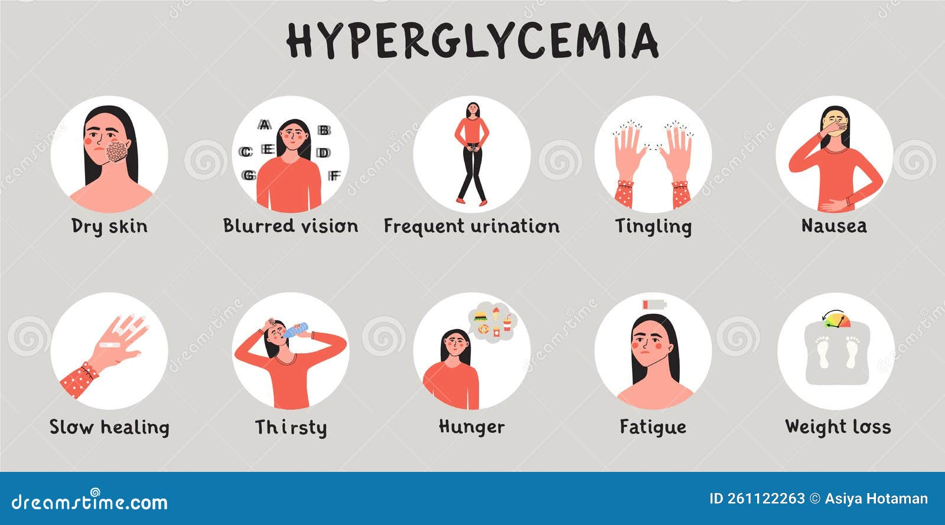
RECOGNIZING HIGH BLOOD GLUCOSE
G

Slide 15
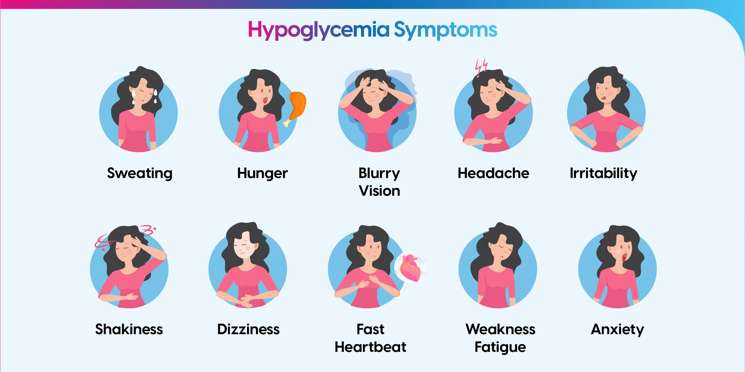
RECOGNIZING LOW BLOOD GLUCOSE
G

Slide 16
Diabetic Emergency Medication
If a student is not able to eat or drink, administer the emergency medication if available.
911 must be called if any emergency medication is administered.
If student does not have medication checked into the clinic, call 911.
May cause nausea and vomiting. Turn student on side if able.
Stay with student until ems arrives
DOCUMENT
Notes:
You may use cake icing to raise blood glucose by placing on cheek. Never give juice to an unconscious student.

Slide 17
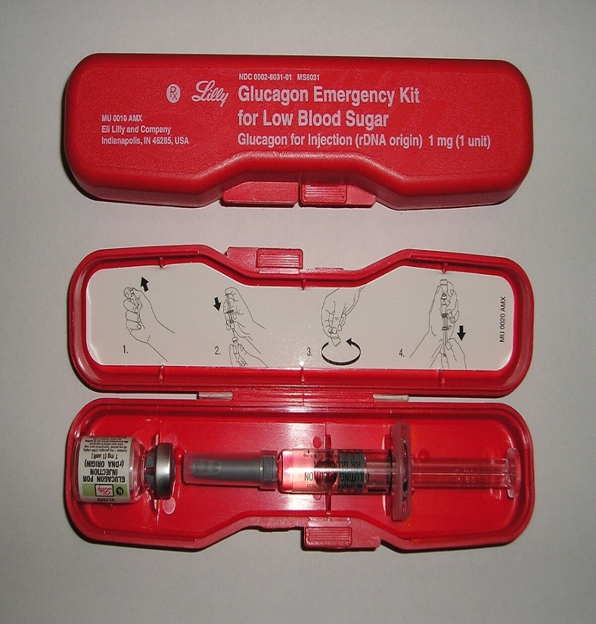
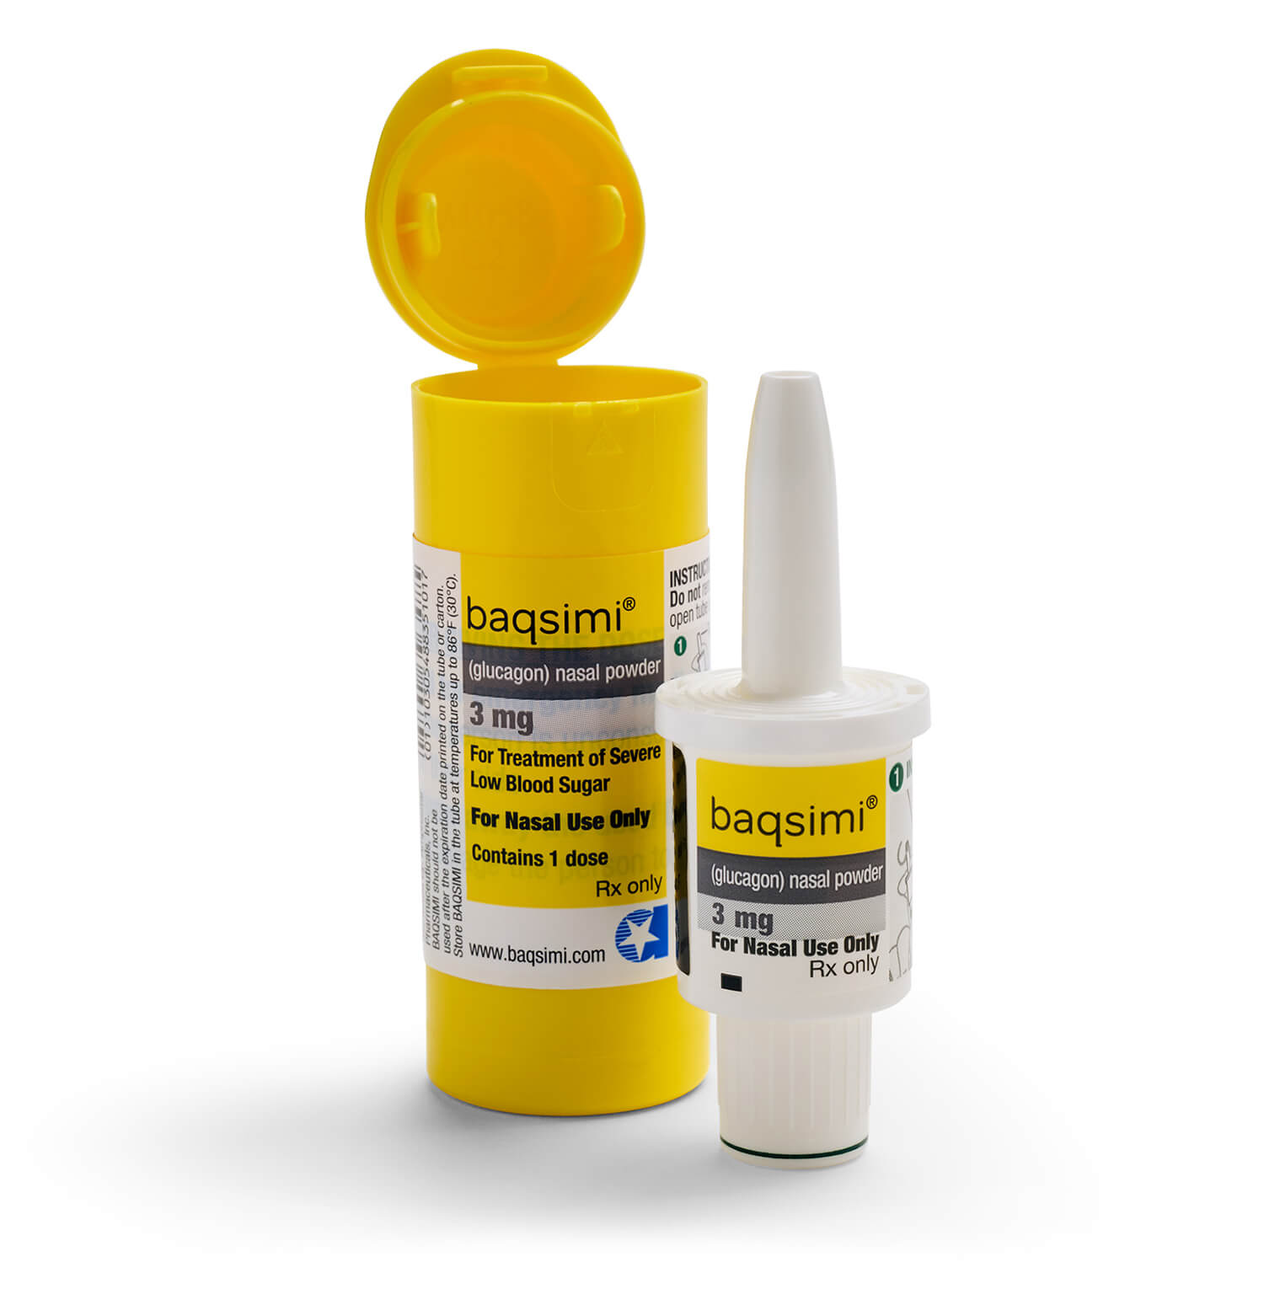
Diabetic Emergency Medication
Glucagon is the emergency medication given.
It can be in the form of an inhalant or an injection.
This Photo by Unknown Author is licensed under CC BY-SA

Slide 18
WHAT IS ANAPHYLAXIS?
A severe, life-threatening allergic reaction that can occur when individuals are exposed to specific allergens

Slide 19
DID YOU KNOW?
Not all allergic reactions develop into anaphylaxis
Early signs can resemble even a mild allergic reaction
Although anaphylaxis typically results in multiple symptoms, reactions vary from person to person
Anaphylaxis usually occurs in a few minutes, but may occur several hours after exposure
Without treatment, anaphylaxis can result in complete airway obstruction, shock, and death
Epinephrine is the drug of choice

Slide 20


Slide 21
BE PREPARED
Recognize symptoms
Be prepared to initiate Emergency Action Plan
Administer epinephrine without delay
CALL 911
Document
Medical event form

Slide 22
EPINEPHRINE
The universal standard to treat Anaphylaxis
Works by constricting blood vessels which raises blood pressure, and opens airways to lungs
Auto injectors contain a single dose of epinephrine, which is injected into the outer thigh
Injection can be given through clothing
Also available in inhalant form.
Administer medication without delay
Fast acting, but effects last only 5 to 15 minutes
Administer promptly at the first sign of anaphylaxis, or any time airway and/or breathing is compromised
It is safer to administer epinephrine than to delay treatment if anaphylaxis is suspected
The sooner anaphylaxis is treated, the greater the chances for survival
Notes:
Always be prepared to begin cpr anytime an emergency medication is given

Slide 23
SEIZURES
A brief, excessive discharge of electrical activity in the brain that alters movement, sensation, behavior, and awareness
Epilepsy is a disorder of the brain characterized by repeated seizures
Common causes of seizures
  Fever-Genetic Factors-Brain Trauma-Anoxia (absence of oxygen) Brain Tumors-Infections of the brain-Brain Injury at Birth
PossibleTriggers
  Missed or Late Medications-Stress-Anxiety-Lack of Sleep or Fatigue Flashing Lights-Illness-Overheating
Notes:
Always be prepared to begin cpr anytime an emergency medication is given

Slide 24
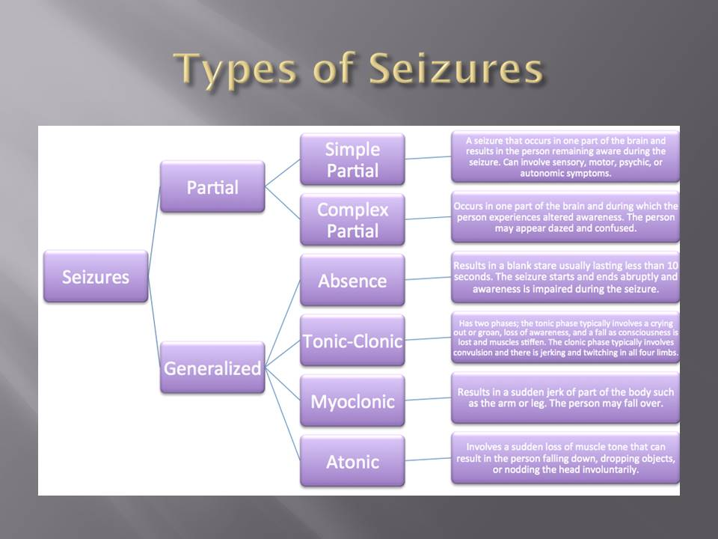

Slide 25
FIRST AID FOR SEIZURES
Stay calm
Talk slowly and softly, do NOT shout
Note time of seizure
Ease to the ground
Do NOT hold down, restrain, force, or restrict
Protect from injury
Remove/loosen tight or restrictive clothing
Do NOT put anything in the student’s mouth
Turn student on side (recovery position)

Slide 26

WHEN IS A SEIZURE AN EMERGENCY?
  First time seizure
  seizure lasting greater than 5 minutes or as directed by student’s Action plan.
  Normal breathing does not resume
  Repeated seizures without return to consciousness between seizures
  change in seizure pattern
  Student is injured
  Student is pregnant or a diabetic
  Emergency medication is administered

Slide 27
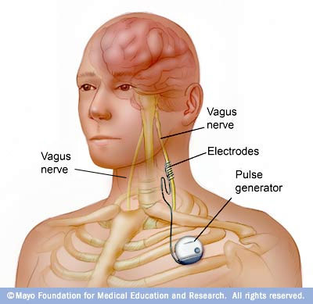
Vagus Nerve Stimulator (VNS)
Used to primarily treat partial seizures when medication is not effective
Device implanted just under the skin usually in the chest with wires that attach to the vagus nerve in the neck
Delivers intermittent electrical stimulation to the vagus nerve in the neck that relays impulses to widespread areas of the brain
Use of special magnet to activate the device, may help prevent or reduce the severity of an oncoming seizure
May still require anti-seizure medication

Slide 28
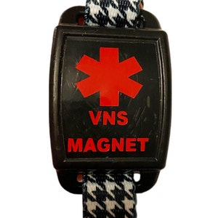
USING A VAGAL NERVE STIMULATOR
Can be used any time during seizure, most likely to work at the beginning of a seizure.
Often used when student feels a sense or warning that seizure may be coming.
Can be used by person with seizures or by another person.
Keep magnet at least 10 inches from anything affected by strong magnet fields.
Swipe magnet across the generator that is under the skin (usually on the left side of the chest) for one second.
Wait 1 to 2 minutes and if seizure is still going on, swipe the magnet again.
Don’t hold magnet over generator. Will turn it off after six seconds.
Must have Physician orders and student specific training

Slide 29
EMERGENCY MEDICATIONS
Medication can come in rectal and inhalant form.
  Diastat
  Nayzilam
  Valtoco
  You must have student specific training by the RN supervisor in order to administer these medications.
  If student does not have emergency medication in the clinic and has a known seizure disorder, 911 will be called at the 5 minute mark.
  Call 911 immediately after administering medication.

Slide 30
WHAT IS ASTHMA?
A chronic Inflammatory disorder of the airways
The lining of the airways become inflamed and swollen
The muscles that surround the airways tighten. Which reduces the width of the airways
Excess mucus production occurs which further narrows the airways.

Slide 31
SYMPTOMS OF ASTHMA ATTACK
Wheezing
Cough
Difficulty Breathing/ Shortness of Breath
Chest Tightness
Retractions-neck area and/or muscles in ribs move inward when breathing
What to look for……..
Anxious or scared
Flared Nostrils
Hunched over body position
Restlessness
Fatigue not related to activity
Trouble Speaking
Lips and/or fingernails are blue

Slide 32
PROVIDING CARE
Stop the activity / remove child from asthma trigger
Stay Calm
Give student rescue inhaler
Pursed lip breathing-inhale through the nose and exhale through the mouth with pursed lips
Have student sit down with hands on knees, leaning forward slightly
If inhaler does not work or student does not have one call 911

Slide 33
Completion
ECSD Staff:
Review this module.
Click link below to access test.
MEDICATION ADMINISTRTION POST TEST 25-26 B.docx
Print and complete the test.
Contact RN supervisor to review test results and complete student specific training.
Store documentation in medication administration book .
Charter or Private School Staff:
Follow steps above. Email the post test to the Health Services coordinator, Betty Hagans at bhagans@ecsdfl.us or fax (850-469-5346)

